Slide 1
FACULTY OF ARTS POSITION ON REVIEW OF EXISTING IGR DRIVES, THEIR IMPACT ON THE UNIVERSITY AND ACTION PLANS TO PROPEL IGR INITIATIVES

Slide 2
Introduction
Arts is one of the Faculties that started the University in 1982. Hence, the Faculty is as old as the University itself.
Two Departments (Department of English and Literary Studies & History (now known as History and International Studies) began the Faculty in 1982.
The Faculty now has seven Departments.

Slide 3
The 7 Departments are:
Department of English and Literary Studies
Department of French
Department of History and International Studies
Department of Linguistics and Nigerian Languages
Department of Philosophy
Department of Religious Studies
Department of Theatre and Media Arts

Slide 4
Objectives of the Programmes in the Faculty are:
(i) To provide students with a sound knowledge of the English Language and Literature in English
(ii) To expose students to the structure of some world Language particularly, Francophone Literature and Civilization
(iii). To comprehend & analyze literary texts in the Language and translate skillfully from English to French Literary, professional and technical texts;
(iv). To provide basic training in the academic study of History and International Studies leading to the formation of informed citizenry.

Slide 5
Objectives of the Programmes in the Faculty are:
To provide students with a sound knowledge of the English Language and Literature in English
(v). To introduce students to all facets of Nigerian, African, European, Asian and American History as well as issues of International affairs such as terrorism and religious fundamentalism etc.
(vi). To equip the students with the knowledge of adequate analysis of language with great emphasis on the Nigerian languages.
(vii). To give the students a broad, thorough and rigorous background not only in the History of Philosophy, but also in all the core areas of Philosophy, such as Logic, Epistemology, Metaphysics, Ethics and Political Philosophy.
(viii) To enable the students understand the phenomenon and social implications of religion in general and the critical and analytical approach to the study of Christian and Islamic Studies.

Slide 6
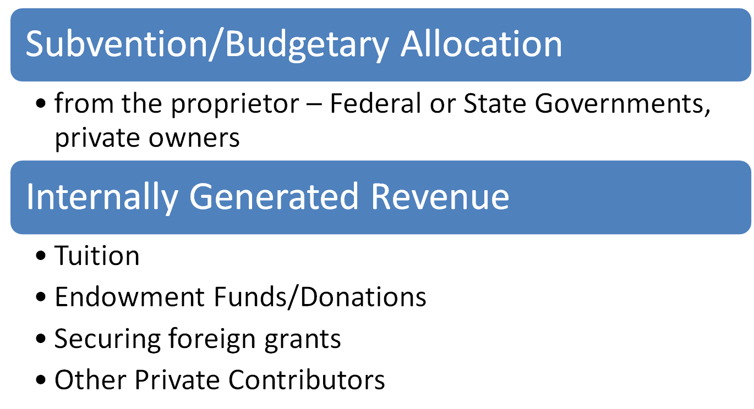
Funding in the University/Faculty: Two Means of Funding

Slide 7
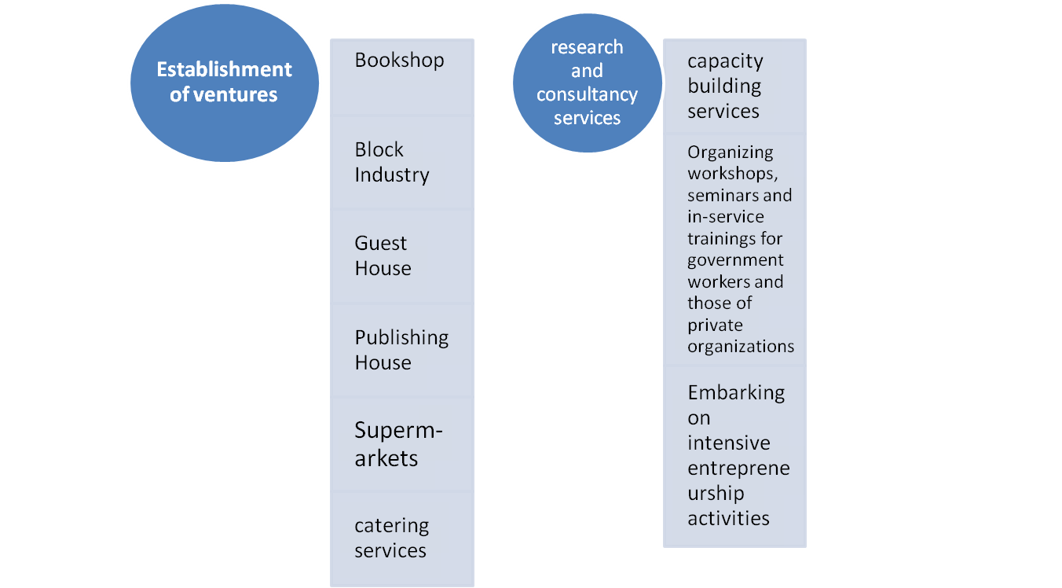
Review of Existing IGR Drives in the University/Faculty

Slide 8
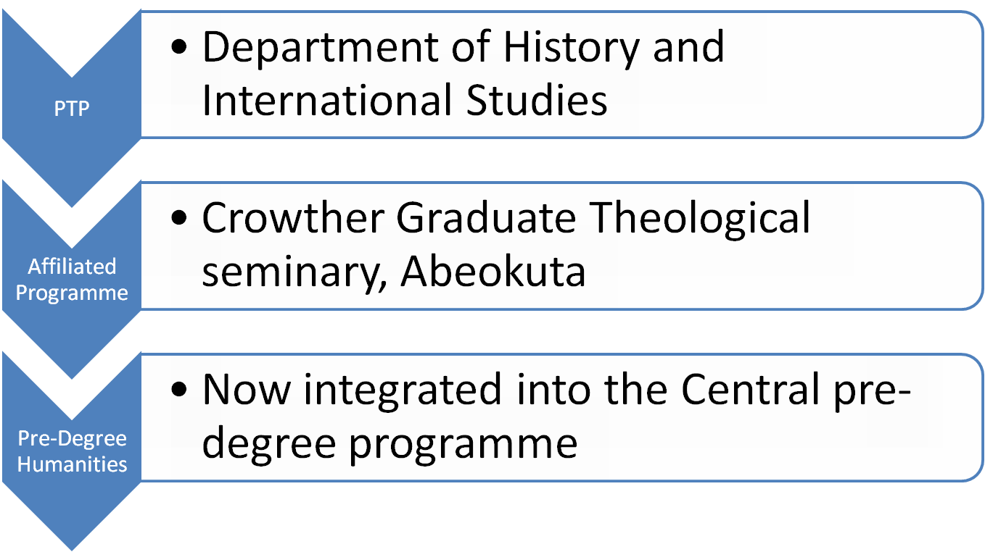
IGR Drives in the Faculty of Arts (EKSU)

Slide 9
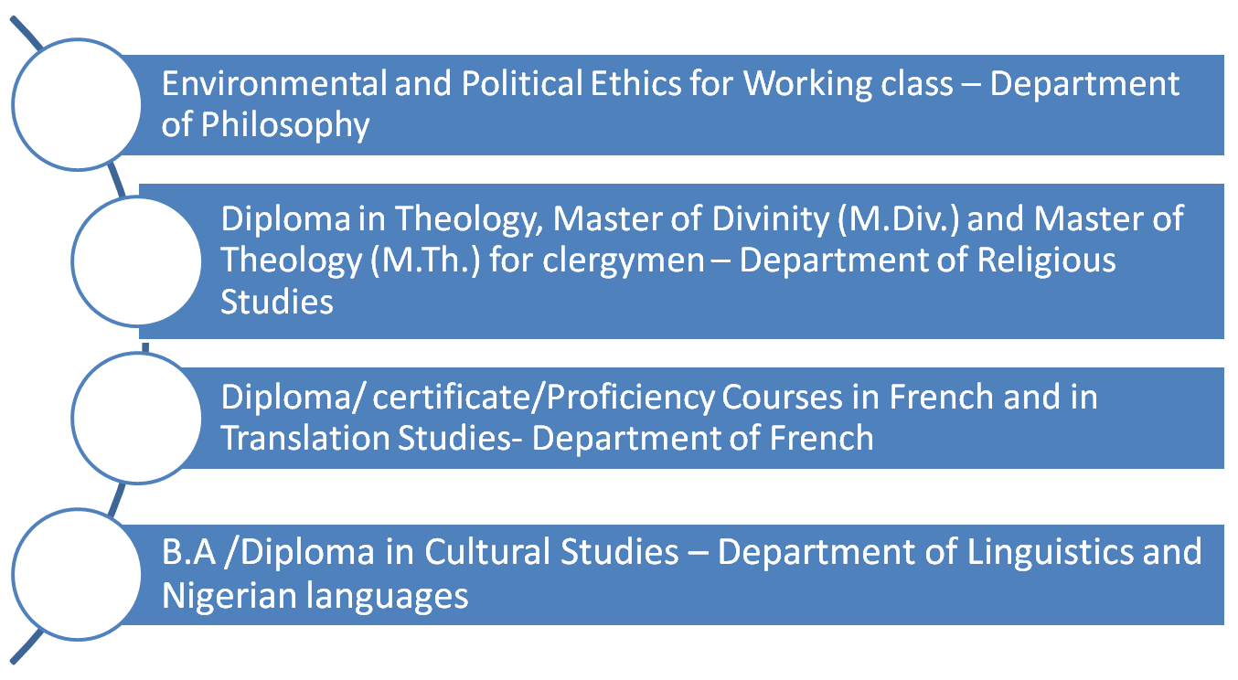
ACTION PLANS OF THE FACULTY OF ARTS: Floating New Academic Programmes:

Slide 10
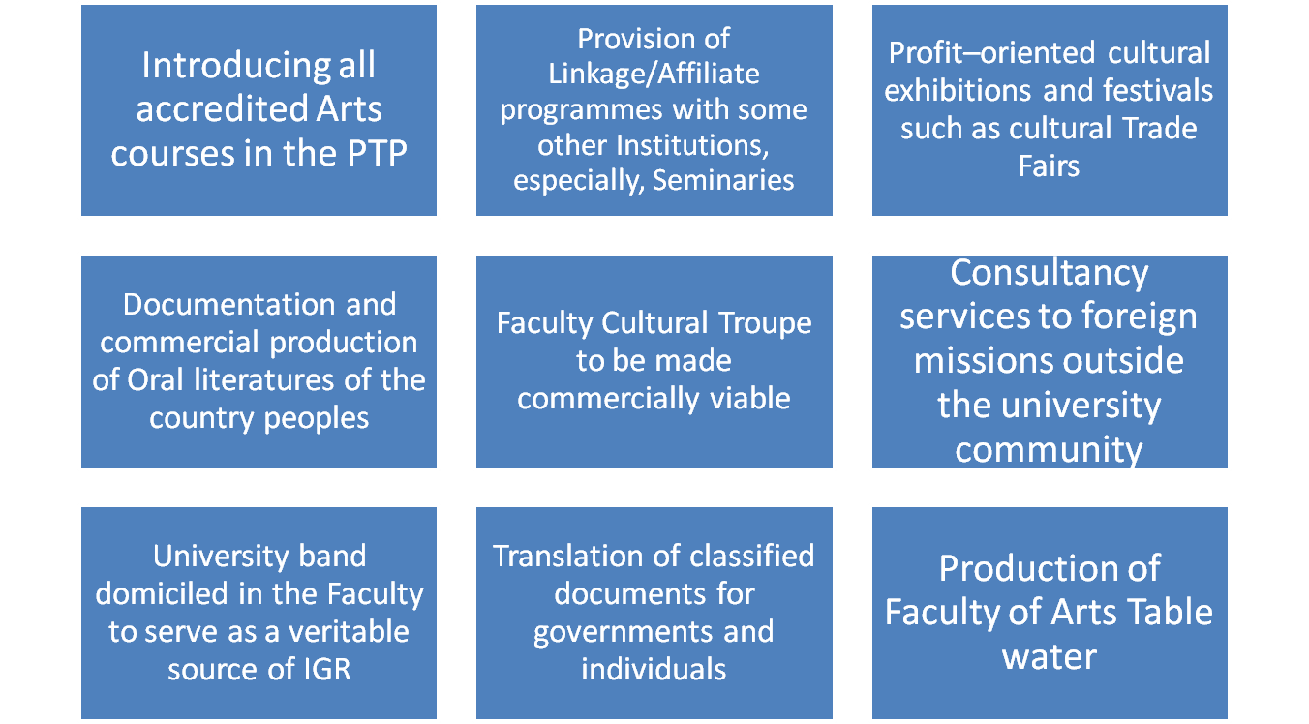
ACTION PLANS OF THE FACULTY OF ARTS: Other innovative ways for better impact and income to the University

Slide 11
Thank you for your attention

